Slide 1
Social Entrepreneurship
Bessie B. Moore Center for Economic Education

Slide 2
Council for Economic Education Conference
October 2012
Ms. Heather Grosze, MAEEE
Business Education
Heritage High School
Rogers Public Schools
Dr. Rita Littrell
Bessie B. Moore Center for Economic Education
Sam M. Walton College of Business
University of Arkansas

Slide 3
Entrepreneurship
Recognized the market opportunities.
Person who organizes the factors of production to produce a good or service.
Takes the risk.
Works to produce the best product at the lowest cost in order to increase the profit margin and to be competitive.
Motivated by profit.

Slide 4
Social Entrepreneurship
Recognizes the social opportunities.
Person who organizes the factors of production to produce a good or service that benefits humankind.
Takes the risk.
Works to produce the best product at the lowest cost in order to provide more or to use any profit to produce support the organization.
Motivated by opportunity to make a difference.

Slide 5
Social Entrepreneurship
Champions change
Capitalizes on idea that makes the world a better place
Build companies that solve problems and/or hire people in need
Aims to effect social change through the use of sustainable business techniques
Involves organizing businesses that directly address social issues

Slide 6
Social Enterprise & Non-Profit
Many types of organizations under its umbrella
Non-profits with business acumen
For-profits whose business models focus on social change
Non-profit incomes come from government and private donors – Heifer International
For-profit social ventures use earned income to improve communities and expand business
Ex. Tom’s Shoes

Slide 7
Current Practice
Increasing independence from non-profits
More social ventures are actual businesses that implement positive change
As opposed to socially responsible organizations
Internet & mobile technology have been catalysts
Most high-profile and interesting examples come from the developing world
World is increasingly philanthropic & cause-oriented

Slide 8
Caring is Good Business
Pressing need to make things better
Build sustainable organizations that inspire significant social change
Stabilize communities & create opportunities
You create something more than a source of income

Slide 9
Mohammad Yunus
Bangladeshi Professor of Economics
Founder of Grameen Bank
Developed concepts of micro-credit or micro-finance
Loans given to entrepreneurs too poor to qualify for traditional loans
Unique feature is responsibility to other community members
2006 Nobel Peace Prize

Slide 10
Aravind Eye Care Center - India
Founded in 1970s to eliminate needless blindness
Grown to 4,000 beds in seven hospitals
Surgeons are among the most efficient in the world
Conducts about 300,000 a year – about half are free

Slide 11
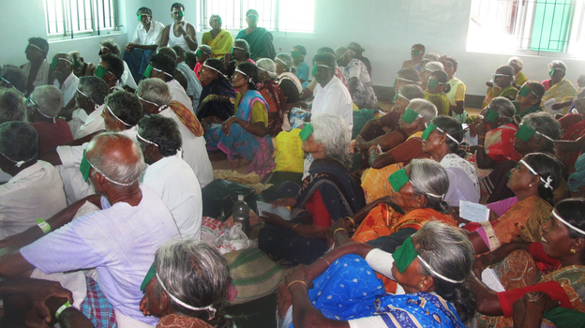

Slide 12
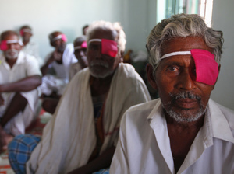
Aravind cont.
45 M people in world are blind
80% could be cured through surgery (cataract surgery)
Dr. V (G. Venkataswamy) founder – belief in the spirituality of service
Embraces its mission by
pursuing efficiency the way
Goldman Sachs pursues profits
Efficiency forces down the
cost of surgery

Slide 13
Aravind cont.
Ability to provide free surgeries was limited by high cost of intraocular lenses
Help of American social entrepreneur, David Green
Green collected 25,000 donated lenses a year – cost was $200 to buy
Set up lens manufacturer on-site
Business model enables company to scale – not dependent upon charity
Squeezed out middlemen profits provides lenses for $2

Slide 14
Social Entrepreneurs Are:
Ambitious
Mission driven
Strategic
Resourceful
Results oriented

Slide 15
SEKEM
With a name that essentially means “vitality from the sun,” this Egyptian company has certainly lived up to its promise by continuously encouraging social, personal and environmental development. Since SEKEM was founded in 1977 by Dr. Ibrahim Abouleish, a pharmacologist, it has:
Produced medicinal, herbal, gastronomical and aesthetically focused products that serve the needs of its customers
Improved the environment through biodynamic farms
Built an educational establishment for children to emphasize creativity and analytical thought
Instituted a healthcare center devoted to holistic medicine
Notes:
Holistic medicine and health care in Egypt

Slide 16
Amul
Founded in 1946, Amul was established initially as a reaction to unfair milk trade practices in India, inspiring local and marginalized farmers to form cooperatives independent from trade cartels. With the notable help of Tribhuvandas Patel and Verghese Kurien, the Amul cooperative model became so successful that it was eventually replicated all over India in 1965. Amul has since:
Produced excellent value for money food products for customers
Created a lucrative source of income for local dairy farmers in India
Notes:
Helped dairy farmers in India form cooperative

Slide 17
Fifteen
Founded by English celebrity chef Jamie Oliver in 2002, Fifteen started out as an ambitious effort to offer disadvantaged youths (aged 18-24) a means of creating better futures for themselves through the art of good food. The restaurant initiative was named for the 15 young people who originally entered apprenticeships under this program. Since the first establishment opened, Fifteen has:
Delivered delicious Italian food to patrons and opened two other restaurants in Amsterdam and Cornwall
Trained 220 young locals in the art of cooking and hospitality and inspired many of its graduates to pursue successful careers in the restaurant business
Reinforced the value of local produce and cooking techniques
Notes:
England – disadvantage youth to cook – local produce, art of cooking & hospitality

Slide 18
Ladakhi Women’s Travel Company
Named for Ladakh, one of the most beautiful and fascinating places in northern India, the Ladakhi Women’s Travel Company is a travel agency made up of female trekkers and travel guides. It was founded by accomplished Ladakhi trekking guide Thinlas Chorol in 2009, defying trekking industry conventions that heavily favor Ladakhi males. Over the last few years, the Ladakhi Women’s Travel Company has:
Organized educational and ecologically friendly tours, treks and homestays for travelers and tourists
Inspired Ladakhi women to prove that they are equally talented in serving as tour guides in their hometown
Encouraged local economic growth by allowing women to find work within Ladakh
Notes:
India – female travel company – empowering women

Slide 19
Jaipur Rugs
Starting out in Jaipur, India and currently operating from Atlanta, Georgia, Jaipur Rugs is a primarily focused on producing high-quality and socially responsible floor coverings. Founded by NK Chaudhary in 1978, this company elevated the art of knotted carpet weaving by nurturing it at the grassroots level and empowering local artisans by directly connecting them to the global market. Thus far, Jaipur Rugs has:
Produced breathtaking, well-crafted handmade rugs for discerning customers
Continued to connect gifted rug makers to consumers
Sponsored health, literacy, vocational, legal, financial and entrepreneurial initiatives to inspire progress in communities where their artisans work and live
Notes:
India – connected local artists directly to the markets & provided educational initiatives

Slide 20
Global Examples
Istvan Aba-Horvath: Based in Hungary, Aba-Horvath's mission is to aid Roma children in getting an education and simultaneously earning money. http://www.romacentrum.hu/kozhaz/debrecen
Mohammed Bah Abba: Bah Abba has "resurrected" a form of pottery that was originally used in ancient Egypt. This pottery has allowed people to keep their food fresh in the harsh climate of Nigeria.
Abbass Abbass: Abbass started AlManarah in 2005, an organization centered in Israel. His mission is to stop discrimination against disabled people in his country.
Rafael Alvarez: Alvarez's goal is to help American youth extend their outlook beyond graduation from high school to highly skilled jobs by training students with the skills they need to do so. He accomplishes this goal through his organization, Genesys Works. http://www.genesysworks.org/
Anita Ahuja: In India, Ahuja has addressed problems of waste, sanitation, and unemployment into a social entrepreneurial organization. Her business produces high-end accessories, such as wallets and purses, out of plastic waste. http://www.conserveindia.org/

Slide 21
Supporting Organizations
Ashoka: Innovators for the Public
Skoll Foundation (created by eBay’s first president)
Schwab Foundation for Social Entrepreneurship
Canadian Social Entrepreneurship Foundation

Slide 22
Supporting Partners
Sundance Institute
Frontline World
News Hour with Jim Lehrer

Slide 23
Youth Entrepreneurship
Engaging youth voice in solving social problems
Young Social Pioneers – Australia
About Face International – interest free loans and mentoring to middle, high school, and college students
National Social Entrepreneurship Forum – Indian Universities and youth
BILGI Young Social Entrepreneur Awards – Instanbul

Slide 24
Publicity
Fast Company Magazine – top 25 social entrepreneurs
BusinessWeek – 25 most promising social entrepreneurs

Slide 25
Questions?
Bessie B. Moore Center for Economic Education

